Slide 1
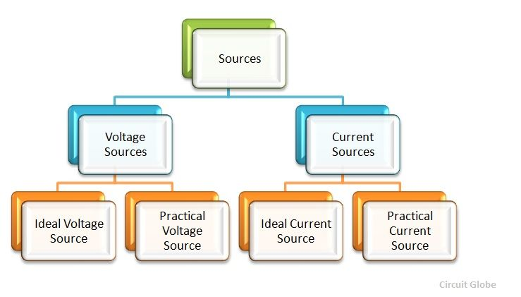
SOURCE
A Source is a device which converts mechanical, chemical, thermal or some other form of energy into electrical energy. In other words, the source is an active network element meant for generating electrical energy.

Slide 2
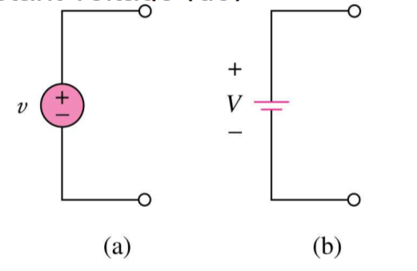
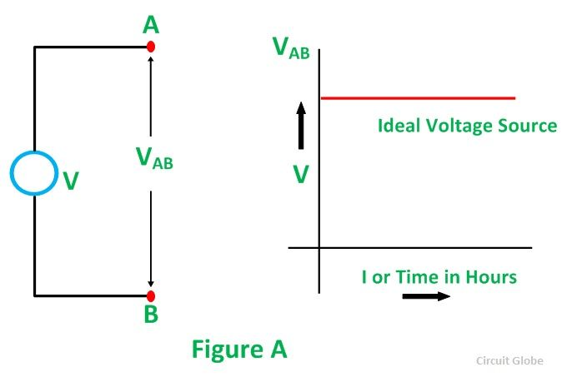
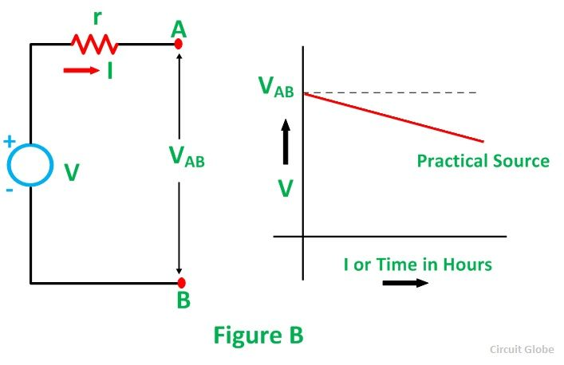
Ideal AND PRACTICAL Voltage Source
Independent sources: An (ideal) independent source is an active element that provides a specified voltage or current that is independent of other circuit elements and/or how the source is used in the circuit.
Symbol for independent voltage source
(a) Used for constant or time-varying voltage
(b) Used for constant voltage (dc)

Slide 3
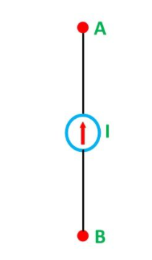
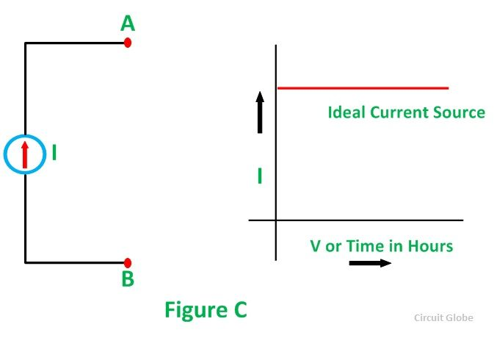
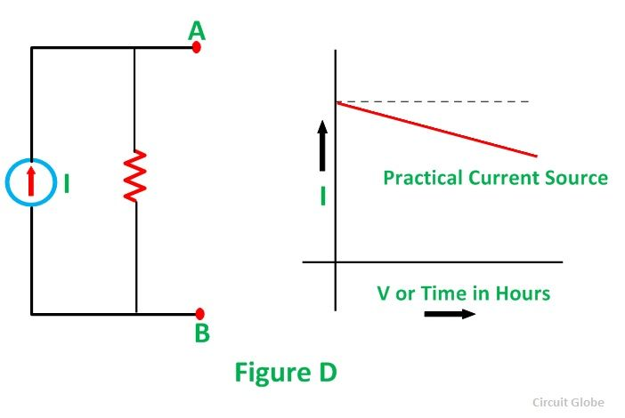
Ideal Current Source
Equivalent representation of ideal independent current sources whose current i(t) is maintained under all voltage requirements of the attached circuit:

Slide 4
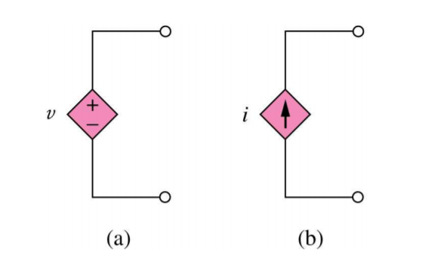
Ideal Dependent (Controlled) Source
An ideal dependent (controlled) source is an active element whose quantity is controlled by a voltage or current of another circuit element.
Dependent sources are usually presented by diamond-shaped symbols:

Slide 5
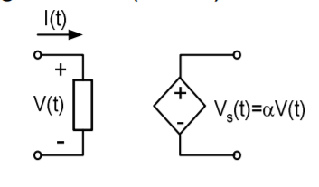
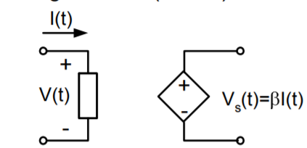
Dependent (Controlled) Source
There are four types of dependent sources:
Voltage-controlled voltage source (VCVS)
Current-controlled voltage source (CCVS)

Slide 6
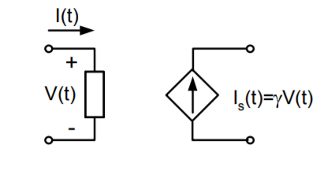
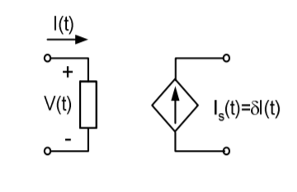
Dependent (Controlled) Source
Dependent (Controlled) Source
Current-controlled current source (CCCS)

Slide 7
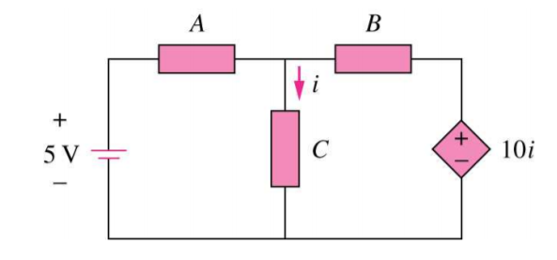
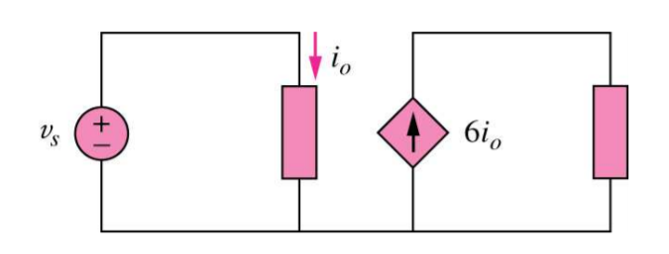
Example: Dependent Source
In the following circuits, identify the type of dependent sources:
Current Dependent Voltage Source
Current Dependent Current Source

Slide 8
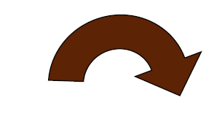
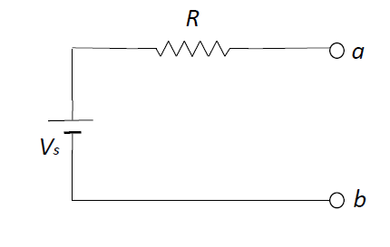
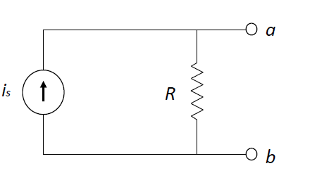
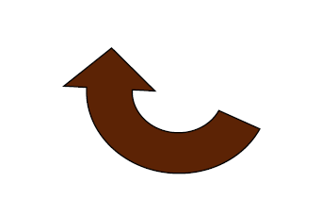


SOURCE TRANSFORMATION
It is process of in which the circuit can be simplify or modified which make our circuit more is to solve
If any circuit is having the voltage source in series it can be converted into current source with parallel with that resistance . This process can be reciprocated
$$I=\frac{V}{R}$$
$$V=I∗R$$

Slide 9
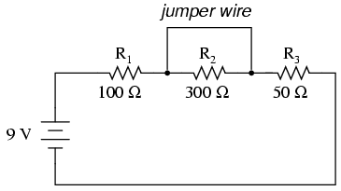
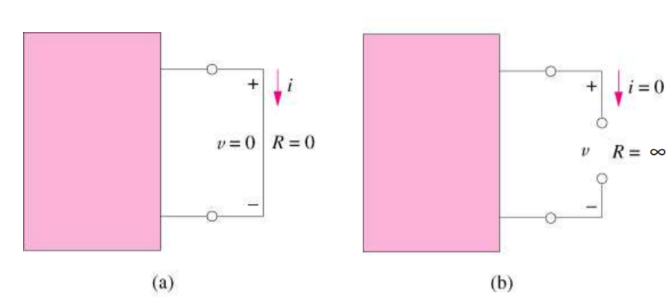

Short and Open Circuits
A device with zero resistance is called short circuit and a device with zero conductance (i.e., infinite resistance) is called open circuit.
$R_{T}=100Ω$+50Ω
$$R_{T}=150Ω$$

Slide 10
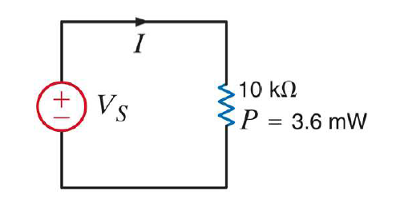

Example
The power absorbed by the 10-kΩ resistor in the following circuit is 3.6 mW. Determine the voltage and the current in the circuit.
We Know, P=VI
Similarly V = IR
$$P=I^{2}R$$
3.6*${10}^{−3}=I^{2}∗10∗{10}^{3}$
$$I^{2}=\frac{\text{3.6*}{10}^{−3}}{10∗{10}^{3}}$$
$I^{2}=0.36∗$ ${10}^{−6}$
$$I=\text{ 0.00189}\text{=1.89}\text{mA}$$
Since we Know I
$$V=\frac{P}{I}=\frac{3.6∗{10}^{−3}}{1.89∗{10}^{−3}}$$
$$V=1.9V$$

Slide 11
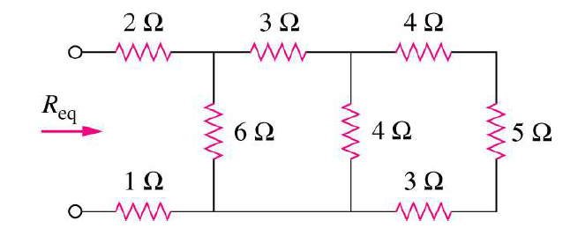
Example
In the following circuit find Req:

Slide 12
Example
In the following circuit find the resistance seen between the two terminal s A and B, i.e., RAB

Slide 13
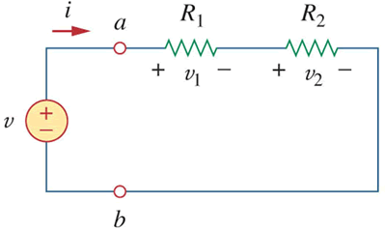

Voltage Division Rule
For resistors in series, the total voltage across them is divided among the resistors in direct proportion to their resistances.
From Ohms Law, $V=I∗R and I= \frac{V}{R}$
In a Series Circuit, $V= V_{1}+V_{2}$
$$V_{1}=I∗R_{1}$$
But $I= \frac{V}{R_{T}}=\frac{V}{R_{1}+R_{2}}$
Substitute in the previous equation we get
$$v_{1}=\frac{R_{1}}{R_{1}+R_{2}}v$$
Similarly
$$v_{2}=\frac{R_{2}}{R_{1}+R_{2}}v$$

Slide 14
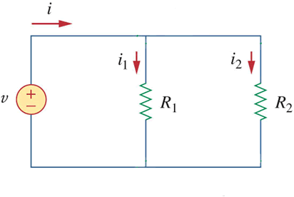

Current Division RULE
For resistors in parallel, the total current through them is shared by the resistors in inverse proportion to their resistances.
From Ohms Law, $V=I∗R and I= \frac{V}{R}$
In a Parallel Circuit, I$= I_{1}+I_{2}$
$$I_{1}=\frac{V}{R_{1}}$$
But V$=I∗R_{T}=I∗\left(\frac{R_{1}R_{2}}{R_{1}+R_{2}}\right)$
Substitute in the previous equation we get
$$i_{1}=\frac{R_{1}R_{2}}{{R_{1}(R}_{1}+R_{2})}i$$
$$i_{1}=\frac{R_{2}}{{ (R}_{1}+R_{2})}i$$
Similarly
$$i_{2}=\frac{R_{1}}{{ (R}_{1}+R_{2})}i$$

Slide 15
Example
In the following circuit find I1, I2, I3, Va, and Vb.

